Slide 1

Data Process Overview
DATA ANALYTICS | FULL-TIME BOOTCAMP

Slide 2

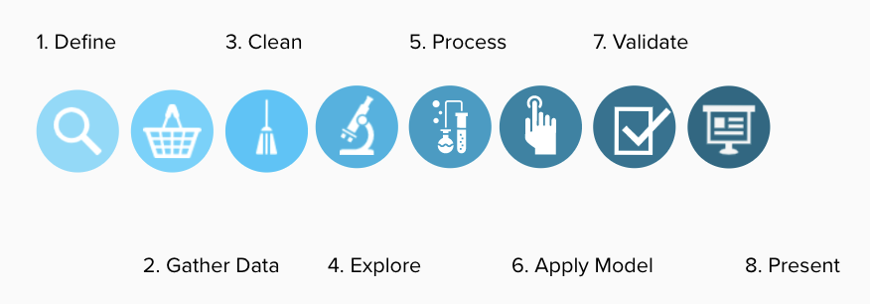
DATA ANALYTICS

Slide 3

🤔
Define the problem

Slide 4
DATA ANALYTICS
How to define the problem?
What is the problem we are trying to solve or the question we are trying to answer?
What is the overall objective? How will we know if we are successful?
What could go wrong?
Is there a method or toolkit we have to use?

Slide 5
🧺
Gather some data

Slide 6
DATA ANALYTICS
What data do we need?
What are the necessary data sources?
Where can we access this data?
How can we extract it?
How can we store it?
How will we keep the data sources up to date?

Slide 7
🧹
Clean the data

Slide 8
DATA ANALYTICS
What information will we need to answer the questions and is it useable?
What are the data types?
What shape is the data in?
What is data cleaning?
What is data wrangling?

Slide 9
🛹
Explore, process, build

Slide 10
DATA ANALYTICS
Which techniques would make our lives easier?
What is analysis?
Do we need Mathematics?
How can we visualise what we have observed?
What is a machine-learning model?
How do we know which approach is best?

Slide 11
🎁
Validate & Present.

Slide 12
DATA ANALYTICS
How does this turn out in the end?
Can we measure the performance and relevance of what we have built?
Is there any bias?
How do we share the results?
Can we automate the end to end processes?
What is the best way to keep this relevant?

Slide 13


